Slide 1
Building AI Agents in LangGraph
Exploring frameworks and practical applications for AI
Notes:
AI-generated content may be incorrect. --- Welcome to this presentation on building AI agents using LangGraph. We'll explore the framework’s capabilities, setup, and practical applications to help you create intelligent AI-driven systems.

Slide 2
Agenda Overview
Title Slide: Building AI Agents in LangGraph
Introduction to Artificial Intelligence
Role of Language Models in AI
Introduction to LangGraph Framework
Setting Up the Environment
Creating a New Project in LangGraph
LangGraph Fundamentals
Building a Basic Chatbot
Adding Intent Handling
Implementing a Sentiment Analyzer
Notes:
This presentation covers an introduction to artificial intelligence, the role of language models, an overview of LangGraph, environment setup, project creation, key concepts, and practical examples like building chatbots and sentiment analysis.

Slide 3
Title Slide: Building AI Agents in LangGraph
Notes:
Starting with the course name and subtitle, accompanied by an engaging AI-themed image to set the tone and context for the learning journey ahead.

Slide 4

Course Name and Subtitle
Course Title
The course is focused on building AI agents using LangGraph framework.
Course Subtitle
The subtitle establishes the course objectives and learning outcomes clearly.
Notes:
--- This slide highlights the title 'Building AI Agents in LangGraph' along with the course subtitle, establishing the focus and objectives of the course. Image source: Microsoft 365 content library

Slide 5
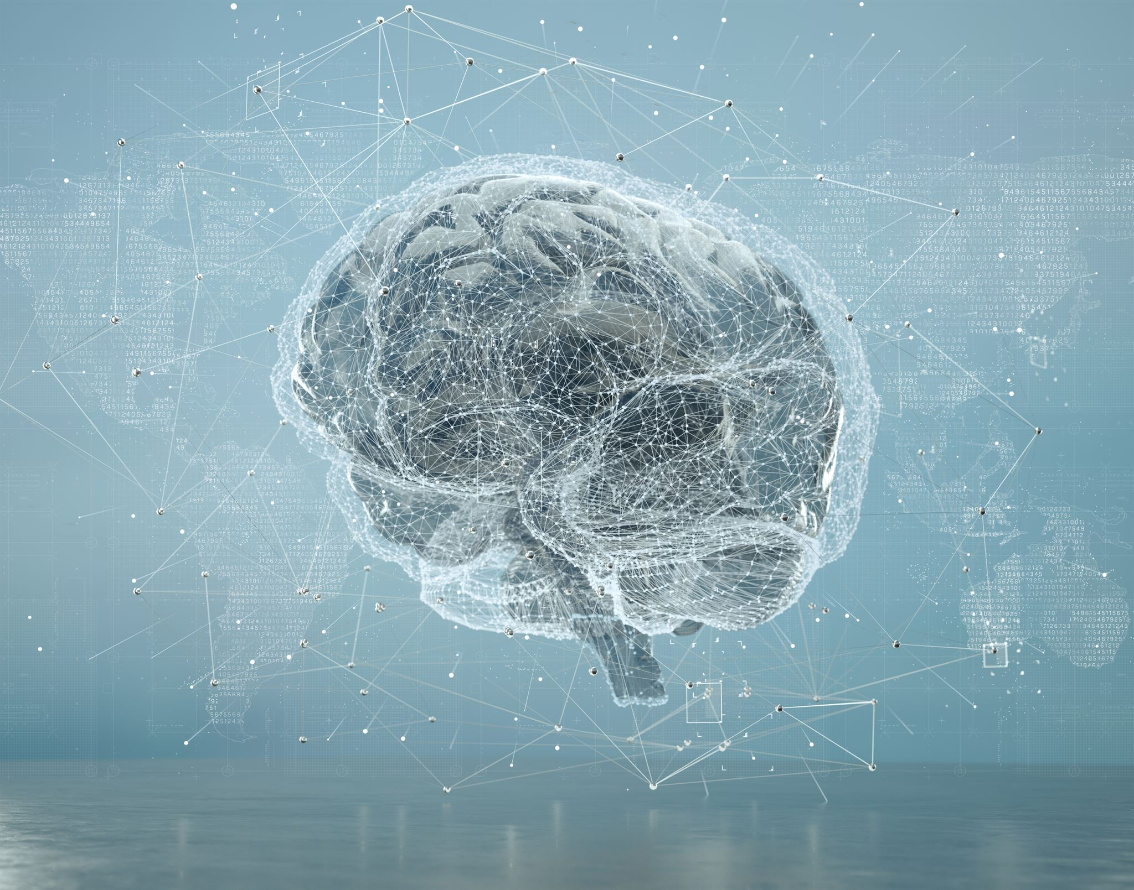
Engaging AI-Themed Image
Modern AI Visual
The visual represents cutting-edge artificial intelligence concepts highlighting innovation and technology.
Captivating Design
The engaging design captures attention and reflects the futuristic nature of AI advancements.
Notes:
--- An appealing AI-related visual designed to capture interest and emphasize the modern and innovative nature of the topic. Image source: Microsoft 365 content library

Slide 6
Introduction to Artificial Intelligence
Notes:
We begin by defining artificial intelligence, discussing its significance and impact on various industries and everyday life.

Slide 7
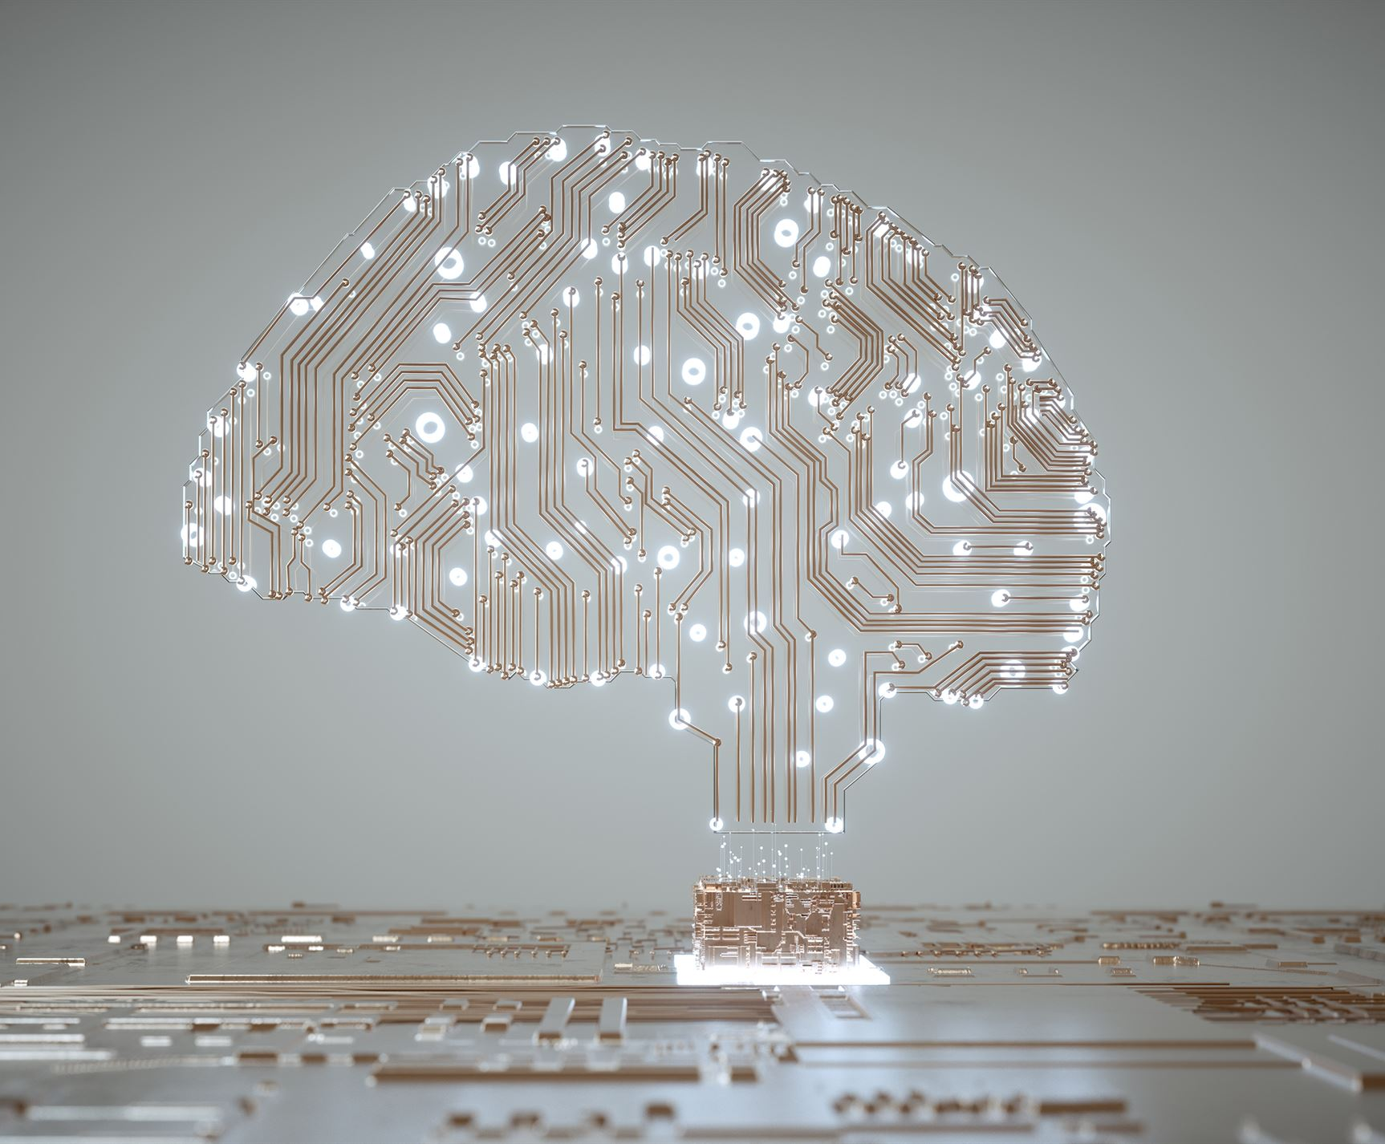
Definition of AI
AI Simulation of Intelligence
AI mimics human intelligence processes through machine-based simulations to perform complex tasks.
Automation and Decision-Making
AI enables automation and helps in making informed decisions by processing vast amounts of data efficiently.
Notes:
--- Artificial Intelligence (AI) is the simulation of human intelligence processes by machines, especially computer systems, enabling automation and decision-making. Image source: Microsoft 365 content library

Slide 8
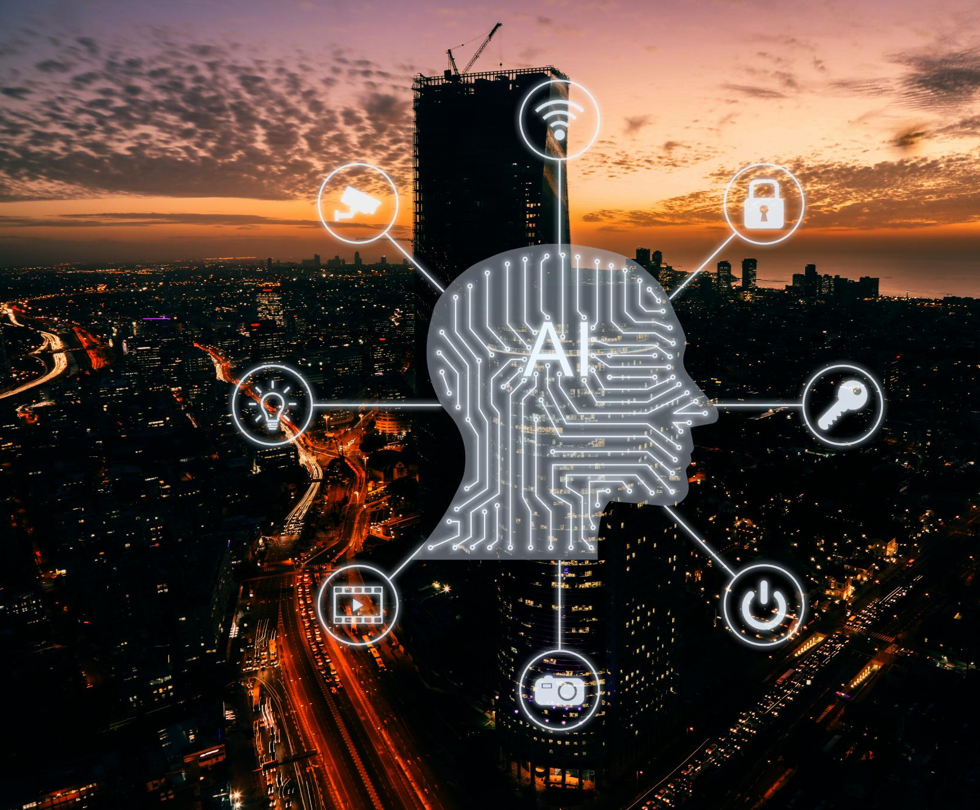
Importance and Impact
Healthcare Transformation
AI improves efficiency and accuracy in healthcare, enabling better diagnosis and patient care.
Financial Innovation
AI drives innovation in finance by optimizing processes and enabling advanced analytics.
Transportation Advancements
AI enhances transportation through improved safety, automation, and intelligent route planning.
Notes:
--- AI has transformed fields like healthcare, finance, and transportation by improving efficiency, enabling new capabilities, and driving innovation. Image source: Microsoft 365 content library

Slide 9
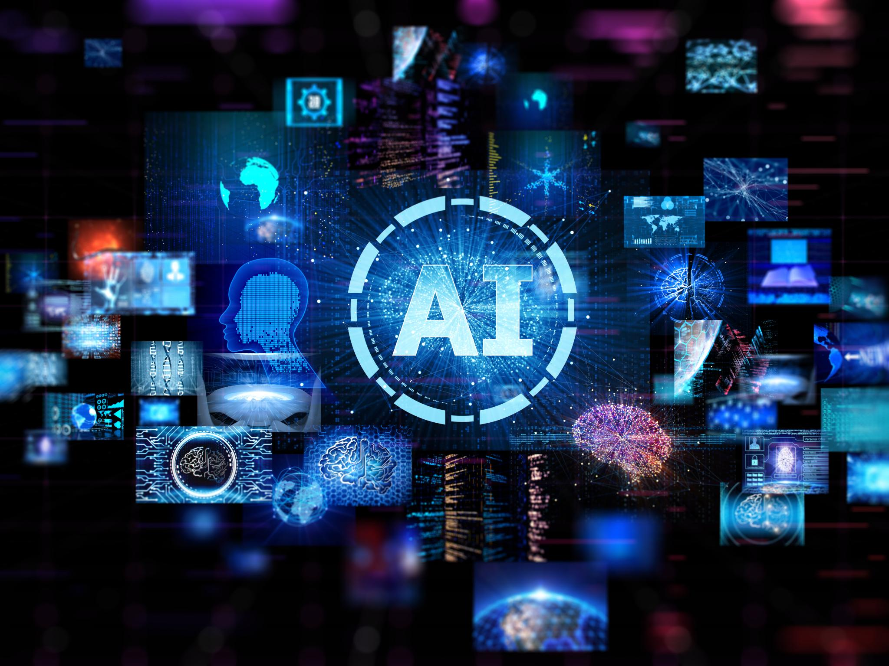
Image: AI Concept Illustration
AI Core Representation
The illustration captures the essence of artificial intelligence with neural network patterns and digital brain imagery.
Conceptual Visualization
Visual elements emphasize AI's complexity and intelligence, aiding in clearer comprehension of its ideas.
Notes:
--- A conceptual illustration to visually represent AI, helping to reinforce understanding of its core ideas. Image source: Microsoft 365 content library

Slide 10
Role of Language Models in AI
Notes:
Language models play a crucial role in AI by understanding and generating human language, powering intelligent agents and applications.

Slide 11

What Language Models Are
Trained Algorithms
Language models are algorithms trained on large datasets to understand and produce human language.
Text Prediction
These models predict the next words or phrases, enabling coherent text generation.
Natural Language Understanding
Language models enable machines to grasp meaning and context within human language.
Notes:
--- Language models are trained algorithms that predict and generate text based on vast amounts of data, enabling natural language understanding. Image source: Microsoft 365 content library

Slide 12

How They Power AI Agents
Understanding User Inputs
AI agents process and interpret user inputs accurately to comprehend intent and context.
Generating Responses
AI agents create meaningful and relevant responses based on the interpreted data.
Performing Language Tasks
AI agents execute various language processing tasks to assist users effectively.
Notes:
--- They enable AI agents to comprehend user inputs, generate meaningful responses, and perform tasks involving language processing. Image source: Microsoft 365 content library

Slide 13

Image: Neural Network Visual
Neural Network Architecture
The visual represents the complex structure of interconnected nodes and layers in neural networks.
Model Complexity
The image helps to visualize the intricate design and complex computations behind language models.
Notes:
--- An image depicting the neural network architecture behind language models to help visualize their complexity and function. Image source: Microsoft 365 content library

Slide 14
Introduction to LangGraph Framework
Notes:
LangGraph is a modern framework designed to simplify building AI agents by combining language models with graph-based workflows.

Slide 15
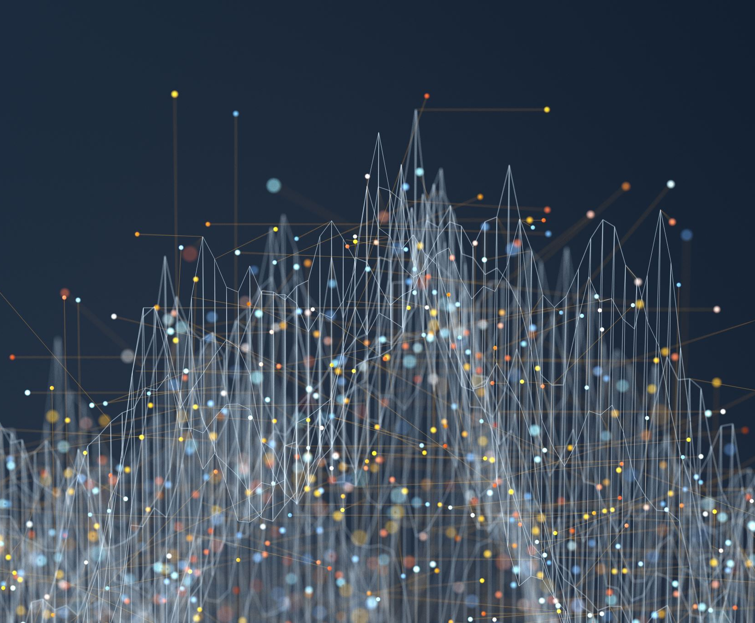
LangGraph Overview
Node Representation
Nodes represent distinct components or entities within LangGraph's AI agent architecture.
Edge Connections
Edges define relationships and interactions between nodes in the AI system.
Flexible AI Design
Integration of nodes and edges enables adaptable and modular AI agent design.
Notes:
--- LangGraph integrates nodes and edges to represent components and their interactions, facilitating flexible AI agent design. Image source: Microsoft 365 content library

Slide 16
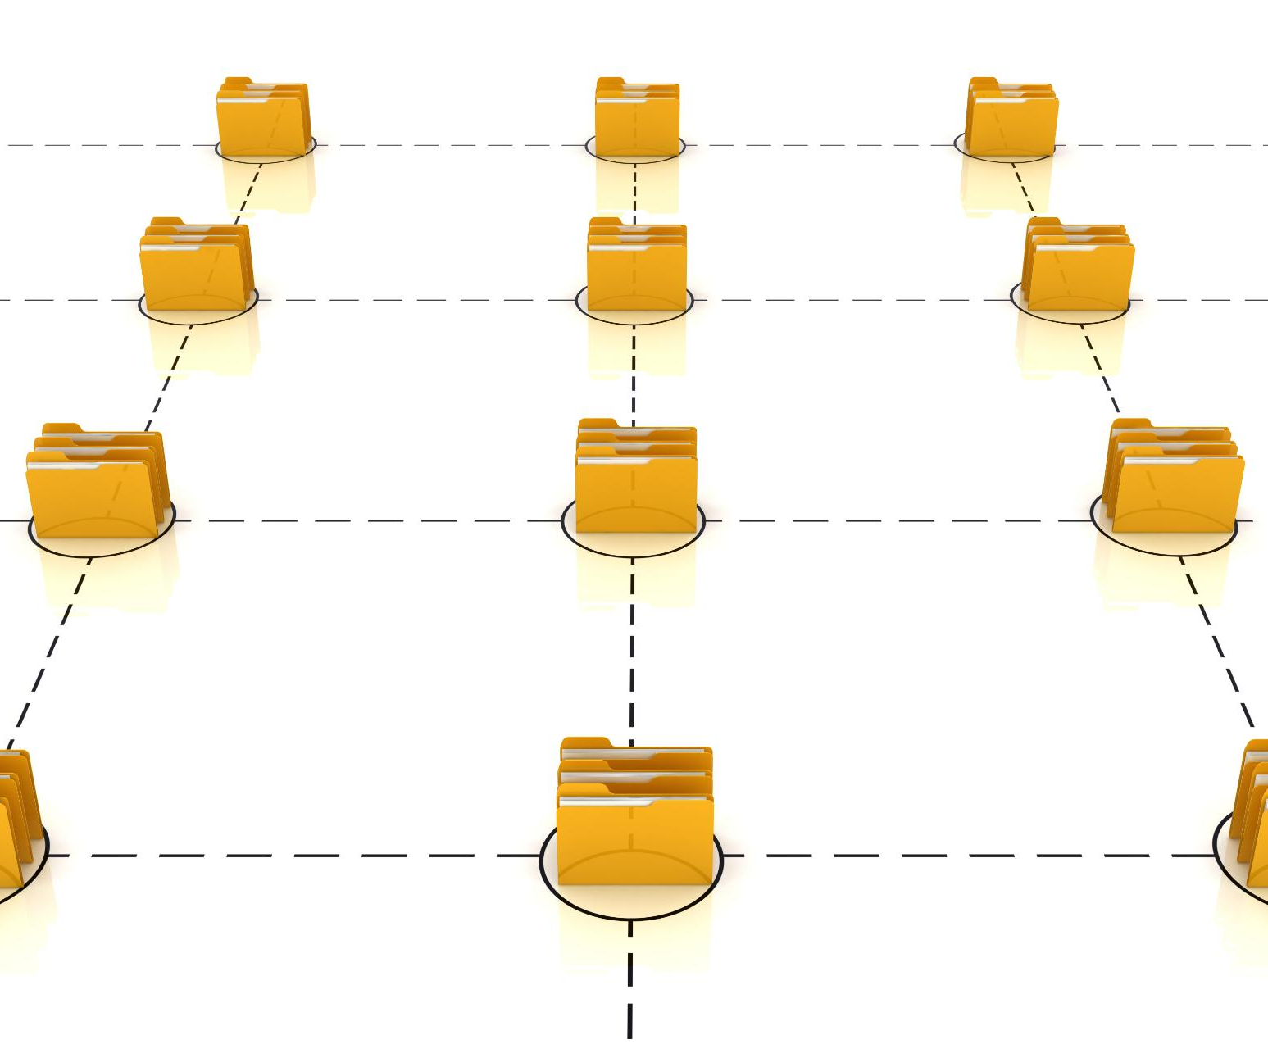
Core Architecture Explanation
Modular Components
The architecture is built with modular components that allow flexible and scalable AI system design.
Nodes and Edges
Nodes and edges define the structure and relationships within the AI framework enabling effective communication.
Flow Orchestration
Flows manage the sequencing and control of AI agent behaviors within the system architecture.
Notes:
--- The framework’s architecture includes modular components like nodes, edges, and flows that orchestrate AI agent behavior effectively. Image source: Microsoft 365 content library

Slide 17

Image: Framework Architecture Diagram
System Architecture Overview
The diagram presents the overall structure of LangGraph's AI framework and its component interactions.
Component Interconnections
Visual representation highlights how different components collaborate to build intelligent AI agents.
AI Agent Building Blocks
The architecture clarifies the foundational elements enabling the creation of AI agents within the framework.
Notes:
--- A visual diagram illustrating LangGraph’s architecture to clarify how its components interconnect for building AI agents. Image source: Microsoft 365 content library

Slide 18
Setting Up the Environment
Notes:
Before building AI agents, setting up your development environment with required software and dependencies is essential.

Slide 19

Installing Python
Primary Language for LangGraph
Python is the main programming language used in LangGraph development.
Install Latest Version
Installing the latest Python version ensures compatibility and access to new features.
Notes:
--- Python is the primary programming language for LangGraph; install the latest version to get started. Image source: Microsoft 365 content library

Slide 20

Adding Dependencies
Install Required Libraries
Ensure all necessary libraries for LangGraph are installed for proper functionality and development.
Manage Package Dependencies
Proper management of dependencies prevents conflicts and ensures smooth execution of LangGraph projects.
Notes:
--- Install necessary libraries and packages that LangGraph depends on, ensuring smooth development and execution. Image source: Microsoft 365 content library

Slide 21

Image: Coding Workspace
Typical Coding Environment
The coding workspace includes a computer setup with code editor software visible on the screen.
Workspace Essentials
Key tools like keyboard and mouse are essential for efficient coding and workspace comfort.
Notes:
--- A snapshot of a typical coding workspace to familiarize you with the environment setup process visually. Image source: Microsoft 365 content library

Slide 22
Creating a New Project in LangGraph
Notes:
Learn how to initiate a new LangGraph project, including project structure and essential practices for organization.

Slide 23

Project Setup Basics
Creating Directories
Organize your project by creating essential directories for code, assets, and configurations.
Configuring Files
Set up configuration files to define project settings and dependencies clearly.
Initializing Project
Initialize the LangGraph project to prepare the environment for development and testing.
Notes:
--- Step-by-step guidance on creating directories, configuration files, and initializing your LangGraph project. Image source: Microsoft 365 content library

Slide 24

Best Practices for New Projects
Modular Design
Use modular design to break projects into manageable, reusable components for better quality and maintenance.
Clear Documentation
Maintain clear and organized documentation to ensure project transparency and ease of understanding across teams.
Version Control
Implement version control systems to track changes, manage collaboration, and preserve project integrity.
Notes:
--- Recommendations such as modular design, clear documentation, and version control to maintain project quality. Image source: Microsoft 365 content library

Slide 25
Image: Developer Tools
Code Editors
Code editors streamline writing and editing code with useful features for developers.
Version Control
Version control tools help manage code changes and collaborate effectively in projects.
Debugging Tools
Debugging tools assist in identifying and fixing bugs to improve code quality.
Notes:
--- An image showcasing popular developer tools that can enhance your productivity when working with LangGraph projects. Image source: Microsoft 365 content library

Slide 26
LangGraph Fundamentals
Notes:
Explore the core components and workflows that form the foundation of AI agent development with LangGraph.

Slide 27

Components: Nodes, Edges, Flows
Nodes as Functional Units
Nodes serve as the fundamental building blocks representing functional units in LangGraph's architecture.
Edges Indicate Connections
Edges represent the links or connections between nodes, establishing relationships within the graph.
Flows Define Execution Paths
Flows specify the direction and sequence of execution paths through nodes and edges in LangGraph.
Notes:
--- Nodes represent functional units, edges indicate connections, and flows define the execution paths within LangGraph. Image source: Microsoft 365 content library

Slide 28

Basic Workflow Overview
Data Flow in AI Graph
Data moves through nodes in the graph to enable processing and decision-making in AI agents.
Control Flow Mechanism
Control signals guide the sequence and timing of operations within the AI agent's graph structure.
AI Agent Functionality
Combined data and control flow enable the AI agent to perform complex tasks effectively.
Notes:
--- An outline of how data and control pass through the graph to enable AI agent functionality. Image source: Microsoft 365 content library

Slide 29
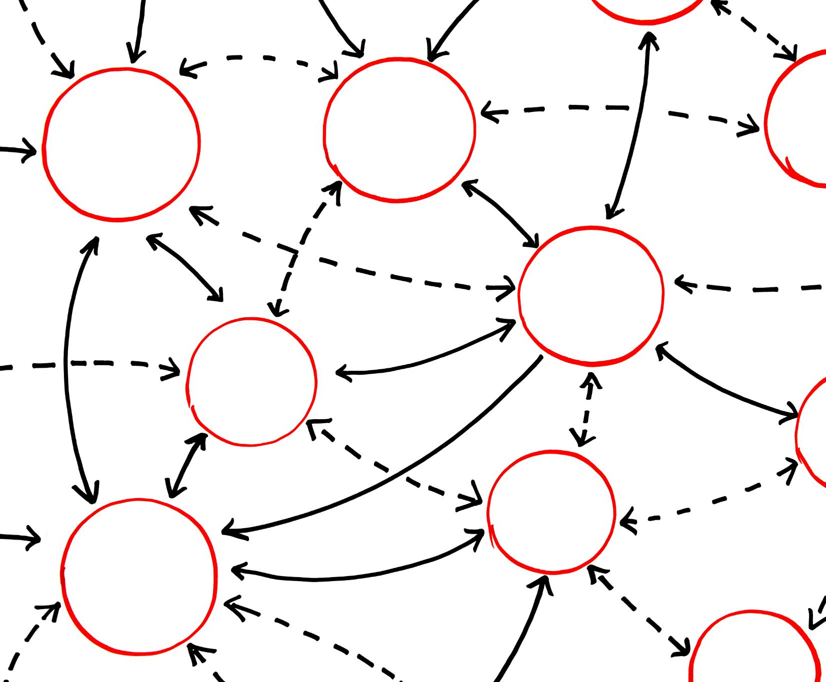
Image: Flowchart-Style Graphic
Workflow Concept Visualization
The flowchart clarifies how LangGraph components dynamically interact within the workflow system.
Component Relationships
The graphic highlights relationships and dependencies among different workflow components.
Notes:
--- A flowchart graphic illustrating LangGraph’s workflow concept to clarify how components interact dynamically. Image source: Microsoft 365 content library

Slide 30
Building a Basic Chatbot
Notes:
We demonstrate creating a simple chatbot that can engage in basic conversations using LangGraph.

Slide 31

Simple Chatbot Logic
Handling User Inputs
Process user inputs efficiently to understand the context and intent behind each message.
Generating Responses
Create accurate and relevant replies based on user input to maintain effective conversation flow.
Conversational Loop
Implement a loop structure to continuously receive inputs and provide responses in real time.
Notes:
--- Implement logic to handle user inputs and generate appropriate responses in a conversational loop. Image source: Microsoft 365 content library

Slide 32

Conversation Demonstration
Chatbot Interaction
The chatbot effectively understands and responds to user queries in a conversational manner.
User Engagement
The demonstration highlights smooth user engagement and seamless communication flow with the chatbot.
Notes:
--- A practical example showcasing the chatbot responding effectively to user queries. Image source: Microsoft 365 content library

Slide 33
Image: Chatbot Icon
Visual Representation
The chatbot icon visually symbolizes conversational AI agents to enhance topic recognition.
Conversational AI Theme
Using the icon helps viewers associate the concept of interactive AI communication easily.
Notes:
An icon representing the chatbot to visually associate with the topic of conversational AI agents.

Slide 34
Adding Intent Handling
Notes:
Enhance the chatbot with intent recognition to better understand user goals and manage conversations.

Slide 35

Managing User Intents and Entities
User Intent Identification
Techniques to accurately detect what a user wants to achieve in a conversation.
Entity Extraction
Methods to extract important information or entities from user input to inform responses.
Dialogue Management Accuracy
Using intents and entities to improve the flow and relevance of chatbot or AI responses.
Notes:
--- Techniques to identify user intents and extract entities for more accurate dialogue management. Image source: Microsoft 365 content library

Slide 36
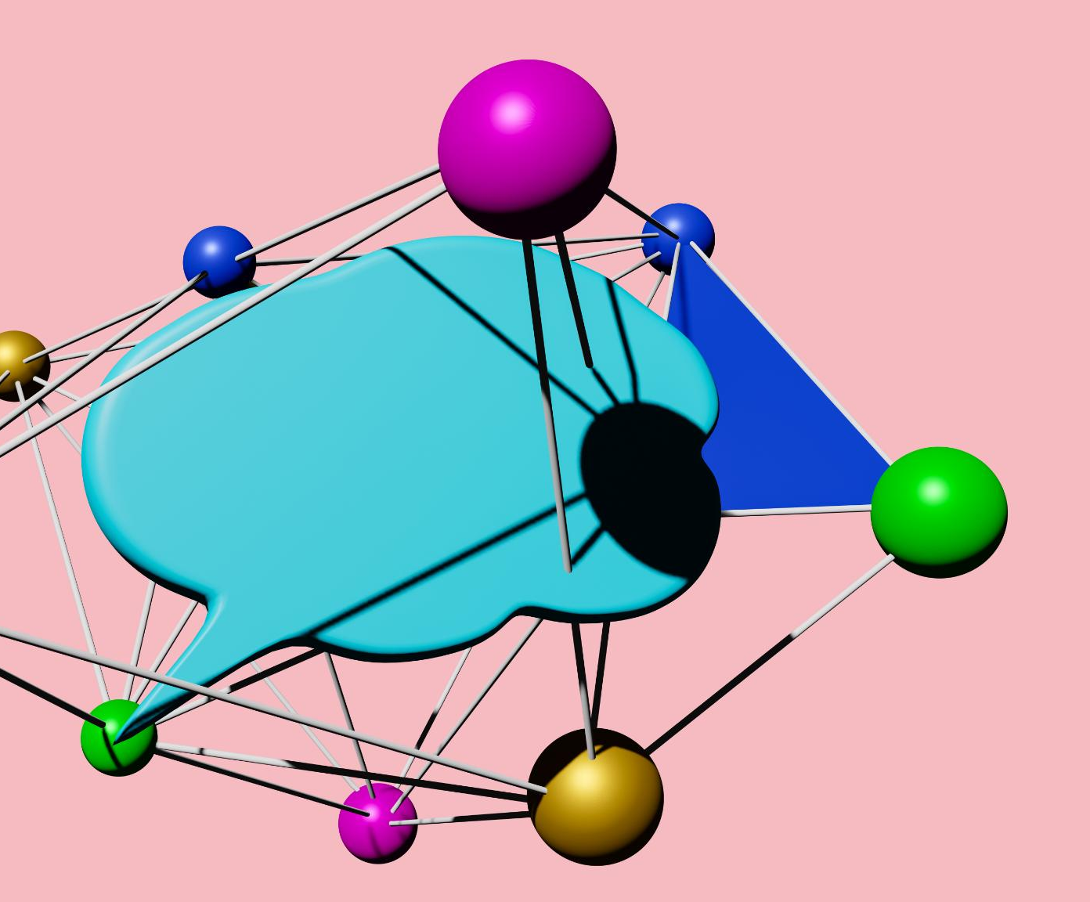
Dialogue Flow Improvements
Natural Interaction
Enhancing conversation flow to sound more natural and human-like during interactions.
Context Awareness
Improving understanding of context to maintain relevant and meaningful dialogue.
Notes:
--- Refinements to conversation flow to create more natural and context-aware interactions. Image source: Microsoft 365 content library

Slide 37

Image: Dialogue System
Dialogue System Architecture
The architecture demonstrates how components work together to process user intents effectively.
Intent Handling Concept
Displays how the system identifies and manages user intents to generate appropriate responses.
Notes:
--- A visual representation of a dialogue system architecture to illustrate intent handling concepts. Image source: Microsoft 365 content library

Slide 38
Implementing a Sentiment Analyzer
Notes:
Incorporate sentiment analysis to classify user input emotions, improving chatbot responsiveness and empathy.

Slide 39

Classifying User Input (Positive, Negative, Neutral)
Sentiment Detection Methods
Techniques analyze text to identify emotional tone as positive, negative, or neutral.
Tailoring Responses
Understanding sentiment helps customize replies to improve user engagement and satisfaction.
Notes:
--- Methods to detect sentiment in user messages to tailor responses accordingly. Image source: Microsoft 365 content library

Slide 40

Integration in LangGraph
Embedding Sentiment Analysis
Integrate sentiment analysis modules into LangGraph for enhanced text understanding capabilities.
Seamless Operation
Ensure smooth operation by embedding modules for real-time sentiment data processing within LangGraph.
Notes:
--- How to embed sentiment analysis modules within the LangGraph framework for seamless operation. Image source: Microsoft 365 content library

Slide 41

Image: Emotion Icons
Variety of Emotions
Icons depict a broad range of human emotions to aid in sentiment classification analysis.
Visual Communication
Emotion icons help convey feelings effectively through simple visual symbols.
Notes:
--- Icons representing various emotions to visually support the concept of sentiment classification. Image source: Microsoft 365 content library

Slide 42
Conclusion
Foundational AI Concepts
Introduced core AI concepts essential for understanding intelligent agents and language models.
Language Models Overview
Explored the role of language models in natural language understanding and generation.
Building Intelligent Agents
Discussed practical steps to build chatbots with intent handling and sentiment analysis capabilities.
Notes:
Today we covered foundational concepts of AI, language models, and LangGraph, including practical steps to build intelligent agents like chatbots enhanced with intent handling and sentiment analysis.

